Slide 1
Information Literacy
Academic Integrity
University of South Dakota Library. University of South Dakota, 2013. Web. 01 Oct. 2013.

Slide 2
What is Academic Integrity?
Academic Integrity is the moral/ethical code that all students and faculty adhere to when they take on the responsibilities of students and teachers.
Essentially, it is the promise to be honest and professional in the presentation and research of work.
Think of Academic Integrity as the rules to live by as a student. We have rules in our society to help protect citizens and we have rules in academics to protect the integrity of students and teachers.

Slide 3
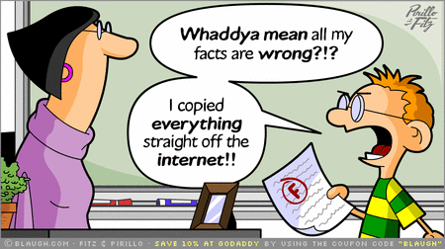
What is plagiarism?
Plagiarism occurs when a student submits another person’s writing as his/her own, has another person dictate what should be written, or has another person write an assignment and submits that work as his/her own.
Plagiarism also occurs when one takes outside sources, includes them in their work, and does not make reference/cite the proper owner or creator of the source.
Patchwork writing: Taking words and phrases from various sources and creating sentences out of them without citing them.
When you are using the exact words of someone else, you must give credit where credit is due. This is done through citation.

Slide 4
Common knowledge
When writing papers and considering your audience, you will need to think about what the common knowledge is.
Previous example used in class: The difference between writing an article about nursing for the Argus Leader and an article for Medical Magazine.
What can you assume about your audience for each medium?
Common Knowledge is a shared knowledge among a group of individuals. Did the class have a common knowledge of the book and film for the comparative analysis unit? Will the reader of your research paper have a common knowledge of your paper topic?

Slide 5
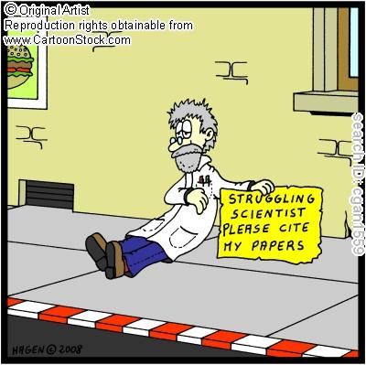
Why is proper attribution important?
It distinguishes your ideas from borrowed ideas.
It helps the reader locate information for further research.
It adds authority and context to your writing.
It acknowledges the work of others.

Slide 6
When should you cite resources?
If you are using a direct quote or words from someone else.
A direct quotation is set off with quotation marks and are called in-text citations when they are used in your paper.
When you are summarizing a work that is not your own.
Summaries cover the main points in a work but skip the specific details.
When you are paraphrasing content from a work that is not your own.
Paraphrasing is restating information you have read in your own words – a new form.
As a general rule, cite all information that you use that is not your own.

